Slide 1

AMD Project
By INSIGHT HUNTERS

Slide 2


AMD
About AMD
Processors (CPUs) – Competes with Intel in producing desktop and laptop processors. Its popular line is:
Graphics Cards (GPUs) – Competes with NVIDIA through its:
Chipsets – Components that support CPUs and GPUs on motherboards.
Embedded Systems & SoCs – Used in gaming consoles (like Xbox and PlayStation), automotive, and industrial devices.
AMD stands for Advanced Micro Devices, Inc. It is an American multinational semiconductor company known primarily for designing and manufacturing

Slide 3
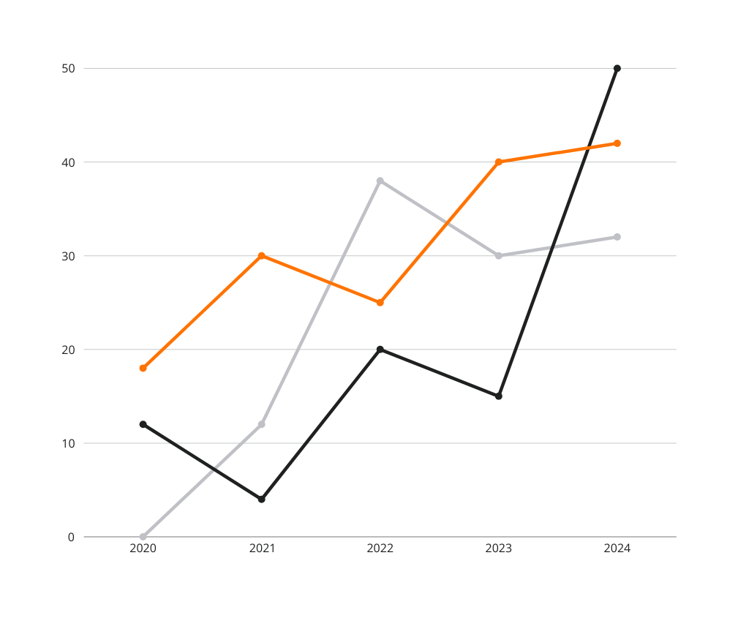
Why AMD
01
Rich, Diverse Data
AMD’s business spans CPUs, GPUs, global sales, stock performance, product launches, and market competition.
This allows you to explore multiple dimensions: sales trends, geography, pricing, performance, and trading data.
02
Real-World Relevance
AMD competes in high-impact industries like gaming, AI, cloud computing, and semiconductors — all hot topics today.
Your analysis will feel meaningful and timely, especially to tech-savvy audiences.
02
Strong Visual Patterns
Revenue breakdowns, stock trends, and product performance naturally lend themselves to visual storytelling using dashboards.
03

Slide 4
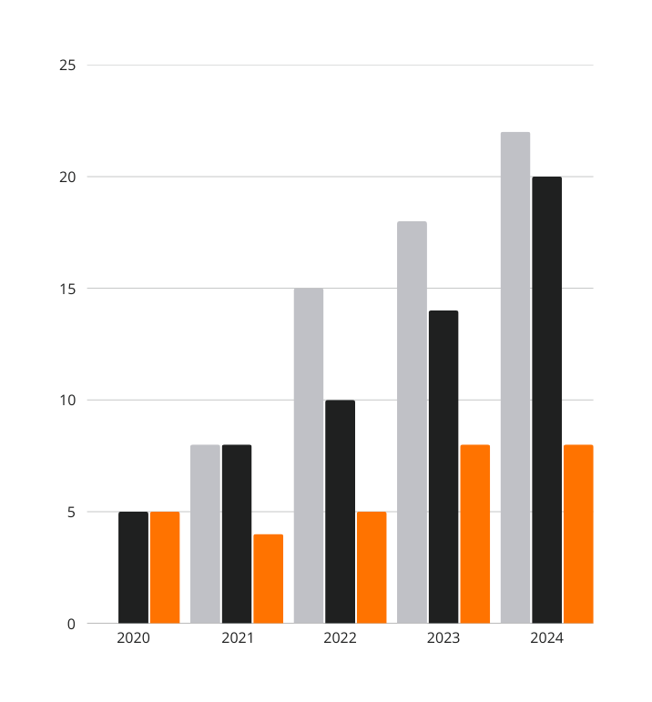
1.Data collection & Preparation Process
1. Web Scraping : To begin, we collected raw data on AMD’s product listings, specifications, and prices from multiple online sources. This included e-commerce platforms and tech product databases.
2. Data Cleaning in Excel : After scraping, the data was exported to Microsoft Excel for cleaning and formatting : Removed duplicate entries, Standardized product names and price formats, Converted performance metrics to consistent scales, Added new columns (e.g., price categories, product series)
Learn More

Slide 5
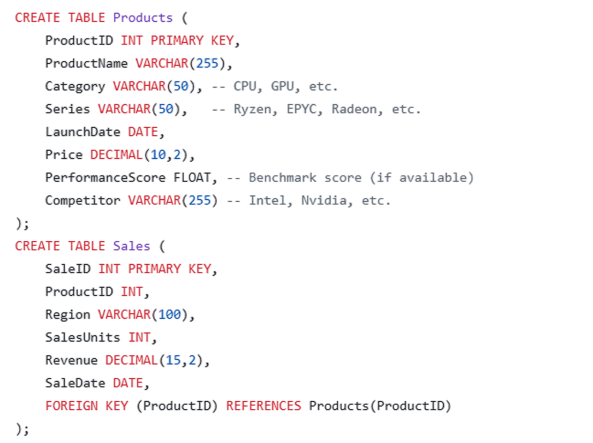
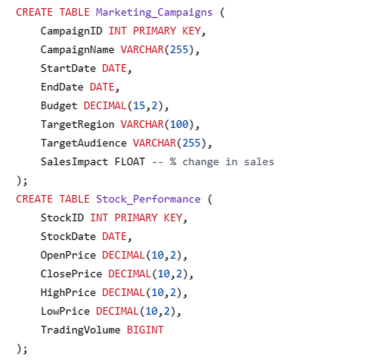
3. Database Structuring with SQL
we imported the cleaned data into a SQL database to Create normalized tables (e.g., Products, Sales, Competitors, Regions), Use SQL queries to join and aggregate data, Calculate metrics like total revenue, average price, and monthly sales volume

Slide 6
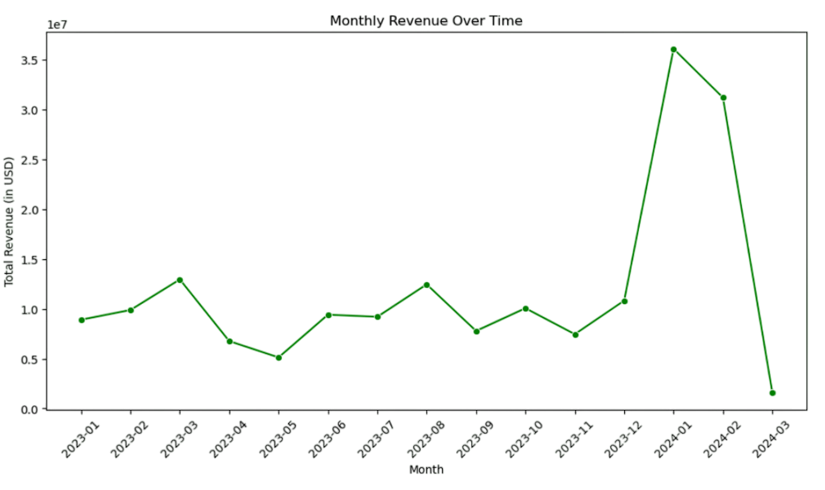
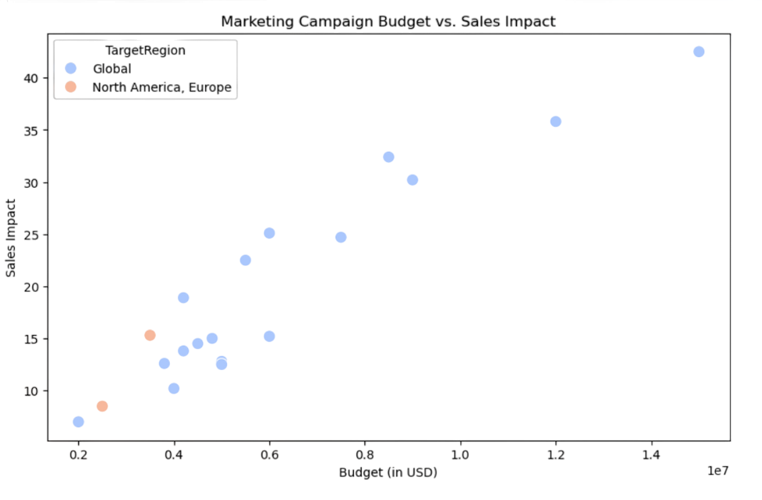
4. Exploratory Data Analysis (EDA) with Seaborn & Matplotlib
Before dashboarding, we conducted initial analysis using: Seaborn for correlation heatmaps, bar charts, and box plots, Matplotlib for line charts and trend visualizations
This helped identify: Relationships between price and performance ,Distribution of sales by region or category, Outliers or unusual data points

Slide 7
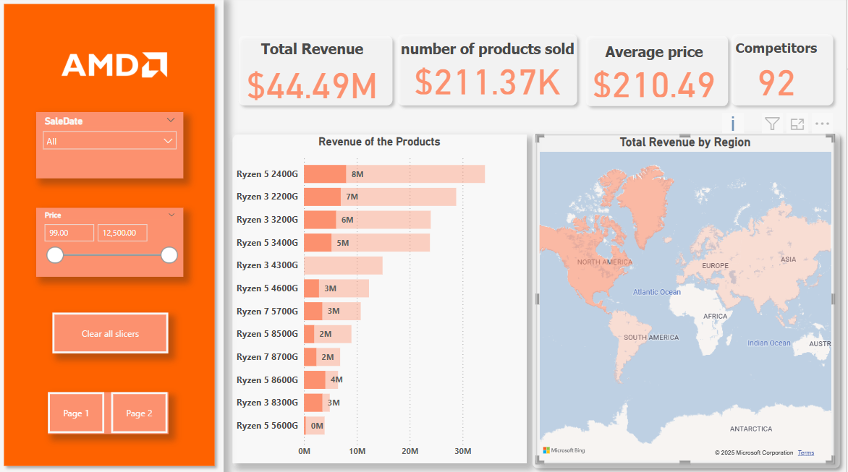
5. Dashboarding in Power BI
We imported the cleaned and enriched dataset into Power BI and created:
KPI cards (Total Revenue, Average Price, Top Products)
Regional heatmaps
Product performance comparisons
Monthly trading volume and stock trends
Interactive filters allowed users to explore data by date, price, or product series.

Slide 8
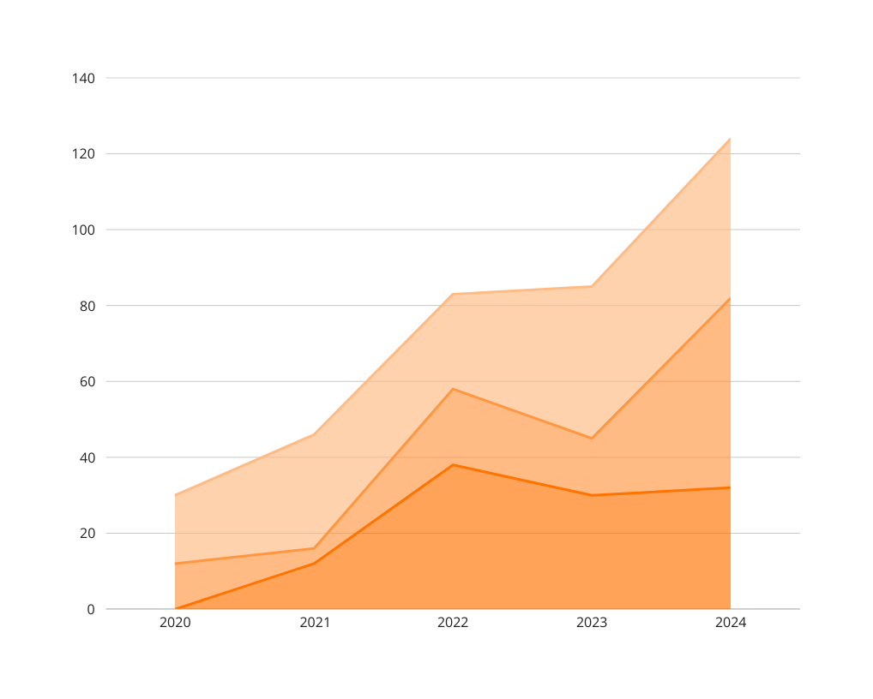
Sales and Revenue Insights
Total Revenue: $179.66M
Number of Products Sold: 883.10K
Average Price: $203.44
Number of Competitors: 92

Slide 9
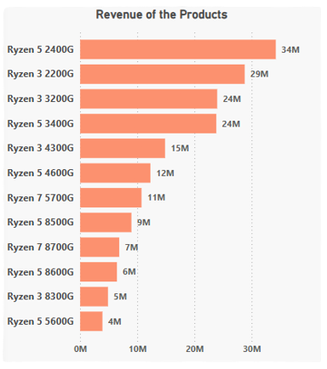
Product Revenue Performance
Top-Selling Products:
Ryzen 5 2400G – $34M
Ryzen 3 2200G – $29M
Ryzen 3 3200G and Ryzen 5 3400G – $24M each
These top four contribute significantly to overall revenue.

Slide 10
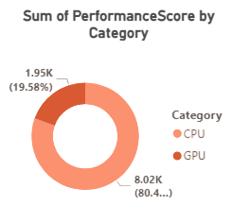
CPU Is AMD's Core Strength
CPU contributes over 80% of the overall PerformanceScore, compared to 19.58% for GPUs.
This indicates AMD’s competitive edge lies more in processors than graphics cards—possibly due to the popularity of Ryzen and EPYC lines.

Slide 11
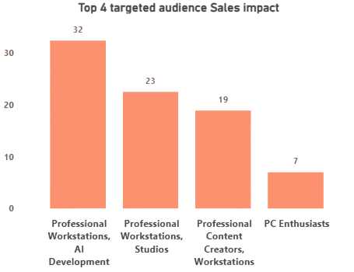
AI Development Drives the Most Sales
Professional Workstations & AI Development (32) is the top sales-driving audience segment.
Suggests AMD's products are well-aligned with high-compute, AI-intensive workflows—a strong strategic position given AI’s growing market.

Slide 12

THANK YOU
By INSIGHT HUNTERS

